Slide 1
MALIGNANT COMMENT CLASSIFIER
SUBMITTED BY:
JUHI MISHRA

Slide 2
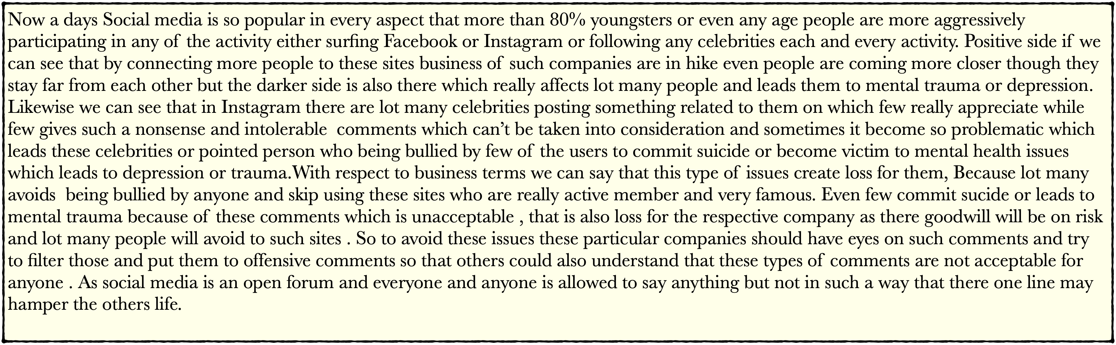
PROBLEM STATEMENT AND UNDERSTANDING

Slide 3
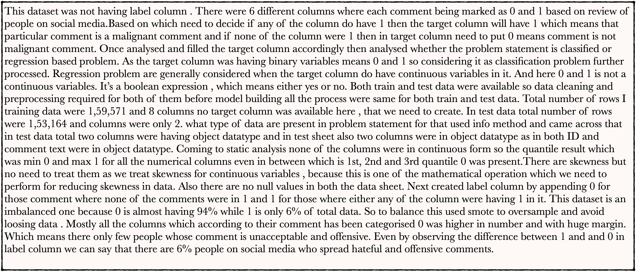
EXPLANATORY DETAILED ANALYSIS - EDA

Slide 4

VISUALISATION ANALYSIS

Slide 5

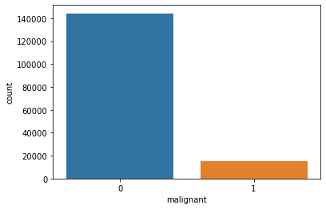
MALIGNANT ANALYSIS
Below with the help of countplot we got insight that 1 which means hateful comment are very less compare to 0 which means non hateful comments. Though the comments done by less people but it being done and we need to filter those columns only. These types of comments are not acceptable.

Slide 6

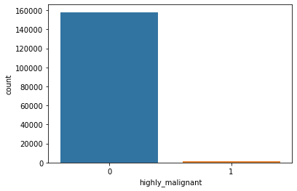
HIGHLY - MALIGNANT ANALYSIS
Though highly malignant comments are way less compare to malignant comments still there are few who are one step ahead in adding such comments on social media which is more harsh. This we can see clearly from below countplot graph where 1 is even less than 5000 while 0 is more than 1 lakh 40 thousand.

Slide 7
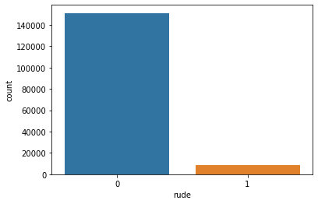
RUDE CATEGORY ANALYSIS
Here in comment section one more category was there which was rude comment. Here rude means anyone who is using some harsh words which is really hurtful and may create issues. Rude comments here done was more than highly malignant but less compare to malignant comments. Though there were no such huge difference between two.

Slide 8

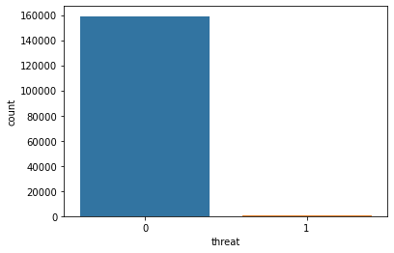
THREAT CATEGORY ANALYSIS
Threat is something which is used when someone is having an intention to inflict pain or damage to that targeted person. These types of comments are considered to be offensive and punishable. Below with the help of countplot we can see that there are very less people who used such kind of comments. Even in percentage we can say 0.5% people used such comments. Compare to all other categories this is way less.

Slide 9

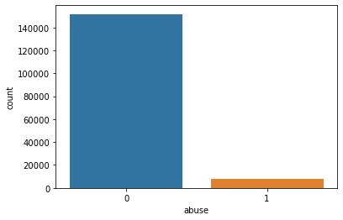
ABUSE CATEGORY ANALYSIS
Abusive is also one of the category of hateful comments only. Someone who is not using good words that we called as abusive comments or using slang language. Here though abusive comments being used more compare to threat and highly malignant but less compare to other categories.

Slide 10


LOATHE CATEGORY ANALYSIS
Loathe is also one of the hateful and abusive category of comments. We can say more Harsh and more way more hateful comments being used. Loathe comments used are lesser compare to all other categories as we can observe with the help of countplot below given.

Slide 11

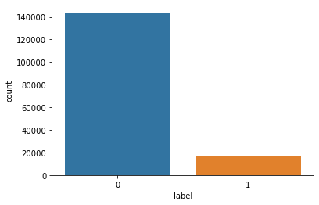
LABEL ANALYSIS (TARGET COLUMN)
Here analysed the label column which is our target column based on all other features. Copiling all means there were total 6 different categories where 0 and 1 given as opinion whether the particular comment is hateful or not. Appended 0 if any of the column were not having 1 and appended 1 if any of the column were having 1. Here 0 means no hateful or offensive comments being used while 1 is vice versa of 0. Approximately 6% of population used hateful and offensive comments. Below we get the insight for the same using countplot.

Slide 12
SKEWNESS ANALYSIS
Skewness analysis here done to check whether there is any skewness in any of the column or not and as we can observe from distplot that all the category column are right side skewed. But no need to treat anything for skewness here as there is no continuous columns though these columns are in numerical form but they are discrete one. And we remove skewness only for continuous column as it’s a mathematical operation.

Slide 13
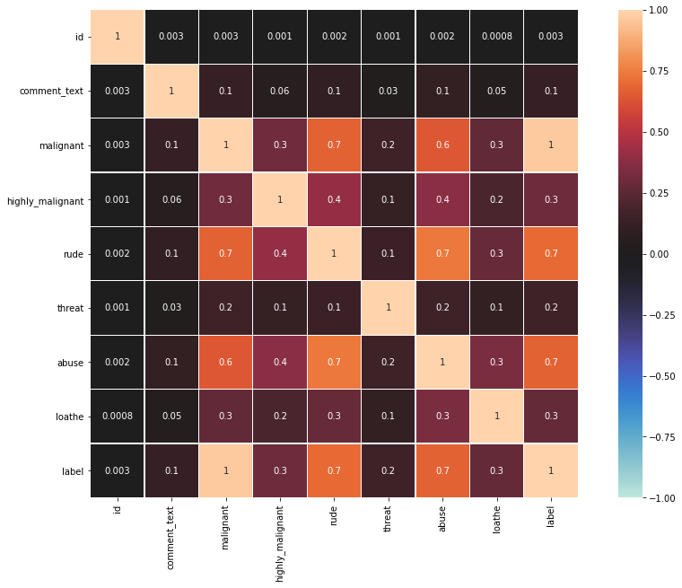
Correlation Analysis using HeatMap
Using heat map we can get an insight that is there any correlation among features. If the correlation is high between two features we need to drop one as overfitting may take place and model performance will get affected. Here mostly threat is correlated to most of the features as the blue is too less for thereat with most of the features. But only on the basis of heat map we can’t drop the column as dropping column means loosing data which may affect our model performance.

Slide 14
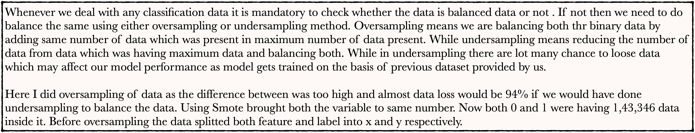
Balancing Data - Oversampling using Smote method

Slide 15
Assumption for completion of Project Undertaken

Slide 16
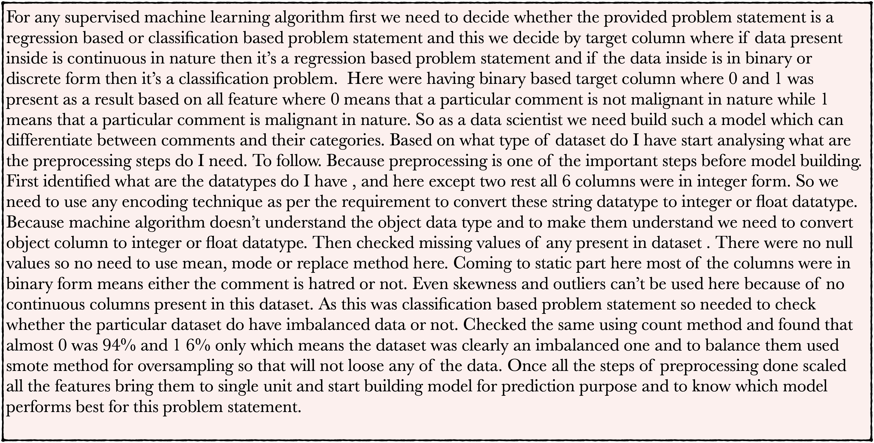

Slide 17
Model Building

Slide 18
As this is a classification based supervised machine learning problem statement so used those model which were classification based algorithms. Below are the list of algorithms which I used for this problem statement :
1. Decision Tree Classifier
2. Regression Forest Classifier
4. Logistic Regression
5. XGBoost

Slide 19
Decision Tree Classifier
The decision tree classifier creates the classification model by building a decision tree. Each node in the tree specifies a test on an attribute, each branch descending from that node corresponds to one of the possible values for that attribute.
For this problem statement Decision Tree Classifier really performed well . Accuracy score is 96% while precision, recall and f1 score too were 96%. And CV score is 96.32%. Which means my model performance on this algorithm is really good.
Below is the classification report with all detail and score :
precision recall f1-score support
0 0.96 0.96 0.96 42954
1 0.96 0.96 0.96 43054
accuracy 0.96 86008
macro avg 0.96 0.96 0.96 86008
weighted avg 0.96 0.96 0.96 86008

Slide 20
Random Forest Classifier
As the name suggests, "Random Forest is a classifier that contains a number of decision trees on various subsets of the given dataset and takes the average to improve the predictive accuracy of that dataset." Instead of relying on one decision tree, the random forest takes the prediction from each tree.
Here performance of Decision tree and Random forest were same both given accuracy score as 96% and CV score 96.32%. So we can’t say that any one of the algorithm works really best for this problem statement .
Below is the classification report for the same where all score such as precision, recall, f1 and accuracy score given .
precision recall f1-score support
0 0.95 1.00 0.97 42954
1 1.00 0.95 0.97 43054
accuracy 0.97 86008
macro avg 0.97 0.97 0.97 86008
weighted avg 0.97 0.97 0.97 86008

Slide 21
Logistic Regression
Logistic regression is a statistical analysis method used to predict a data value based on prior observations of a data set. ... A logistic regression model predicts a dependent data variable by analyzing the relationship between one or more existing independent variables.
Logistic Regression here do have better performance than previous two algorithm with 97% accuracy score. While CV score is 97.39%.
Below is the classification report for the same where all score such as precision, recall, f1 and accuracy score given :
precision recall f1-score support
0 0.95 1.00 0.97 42954
1 1.00 0.95 0.97 43054
accuracy 0.97 86008
macro avg 0.97 0.97 0.97 86008
weighted avg 0.97 0.97 0.97 86008

Slide 22
XGBoost
XGBoost is a decision-tree-based ensemble Machine Learning algorithm that uses a gradient boosting framework. In prediction problems involving unstructured data (images, text, etc.) artificial neural networks tend to outperform all other algorithms or frameworks.
XGBoost score is similar to logistic regression with 97% accuracy score and CV score is 97.42%. Which means both logistic and XGBoost performs with same score.
Below is the screen shot of all score with classification report :
precision recall f1-score support
0 0.95 1.00 0.97 42954
1 1.00 0.95 0.97 43054
accuracy 0.97 86008
macro avg 0.97 0.97 0.97 86008
weighted avg 0.97 0.97 0.97 86008

Slide 23
Conclusion
Internet now a days become part of every individual ans specially social media. Social media is such a platform where most of the population spends there time and try to know the life of others, either it’s a friend , family member, or any celebrities. Here every one free to share there opinion or can put their point of view what they think for others. There is another part which really affects others specially celebs who every day have to be trolled by public. Sometimes few comments are tolerable while some comments are such which really affects their life. These comments affects so much that few of them face the issue of depression, mental illness and even social thought comes to few minds. These hateful, abusive comments should be filtered or to be put into trash so that others life not get affected. Here as a data scientist need to build such a model which can differentiate between comments and it’s categories. To build a model need to collect data related to these comments and need to analyse the data properly so that we can train the model and can predict what result being expected. Once both train and test data collected in the form of CSV format loaded the same to python using pandas in read format. Checked the shape of dataset where in train data total columns were 1,59,571 and columns without label were 8 and after adding label which is our target column were 9, while in test data total rows were 1,53,164 and columns were 2 in which only id for comments and comments column were there and both were in object datatype. In train dataset also comments and id column were in object datatype while all the there category column were in numerical form. Converted object datatype to numerical form using label encoder technique. Machine algorithm doesn’t understand the text to string datatype , to make them understand we need to convert string to integer or float datatype. No null values were present in this dataset. Coming to skewness and outliers no need to remove though skewness were there in numerical columns but as we know that skewness generally we perform for mathematical operation and these operation we do on continuous columns and none of the columns were in continuous form here. Columns which were in numerical form were discrete in nature. Comments being segregated into 6 categories which is malignant, highly malignant, rude, abusive, threat, and loathe. According to the comments done 1 and 0 value being given respectively i.e., 0 for non hateful comments and 1 for hateful comments. Where using visualisation technique we can observe that hateful comments ratio are too less compare to good comments where threat category were almost nill. All together there were 6% population who do such kind of comments. And we need to filter these only. As we can see in our target 0 and 1 was given means either yes or no which means it’s in binary form. So this is classification dataset and in classification problem we need to check whether the dataset is balanced or not. Checked using count method and found that there is a huge difference between the value of 0 and 1. So to balance the same used smote method to oversample the data and to avoid data loss. As data loss lead our model not to perform well.Once all the preprocessing done scaled all the feature using standard scaler to bring all the unit to same label. Next found best random state so that will train our model on the same. Segregated 70% and 30% respectively for training and testing purpose . Which means my model will be trained on 70% data and will predict on the basis of 30% data. Then choose 5 models which were Decision Tree Classifier, Random Forest Classifier, SVC, Logistic Regression and XGBoost. Among all almost three model were having same performance and given highest accuracy and CV score which was 97% . Based on score did hyperparameter tuning for SVC algorithm using GridSearchCV. Then saved the model using job lib. And predicted on the basis of test dataset.

